Slide 1
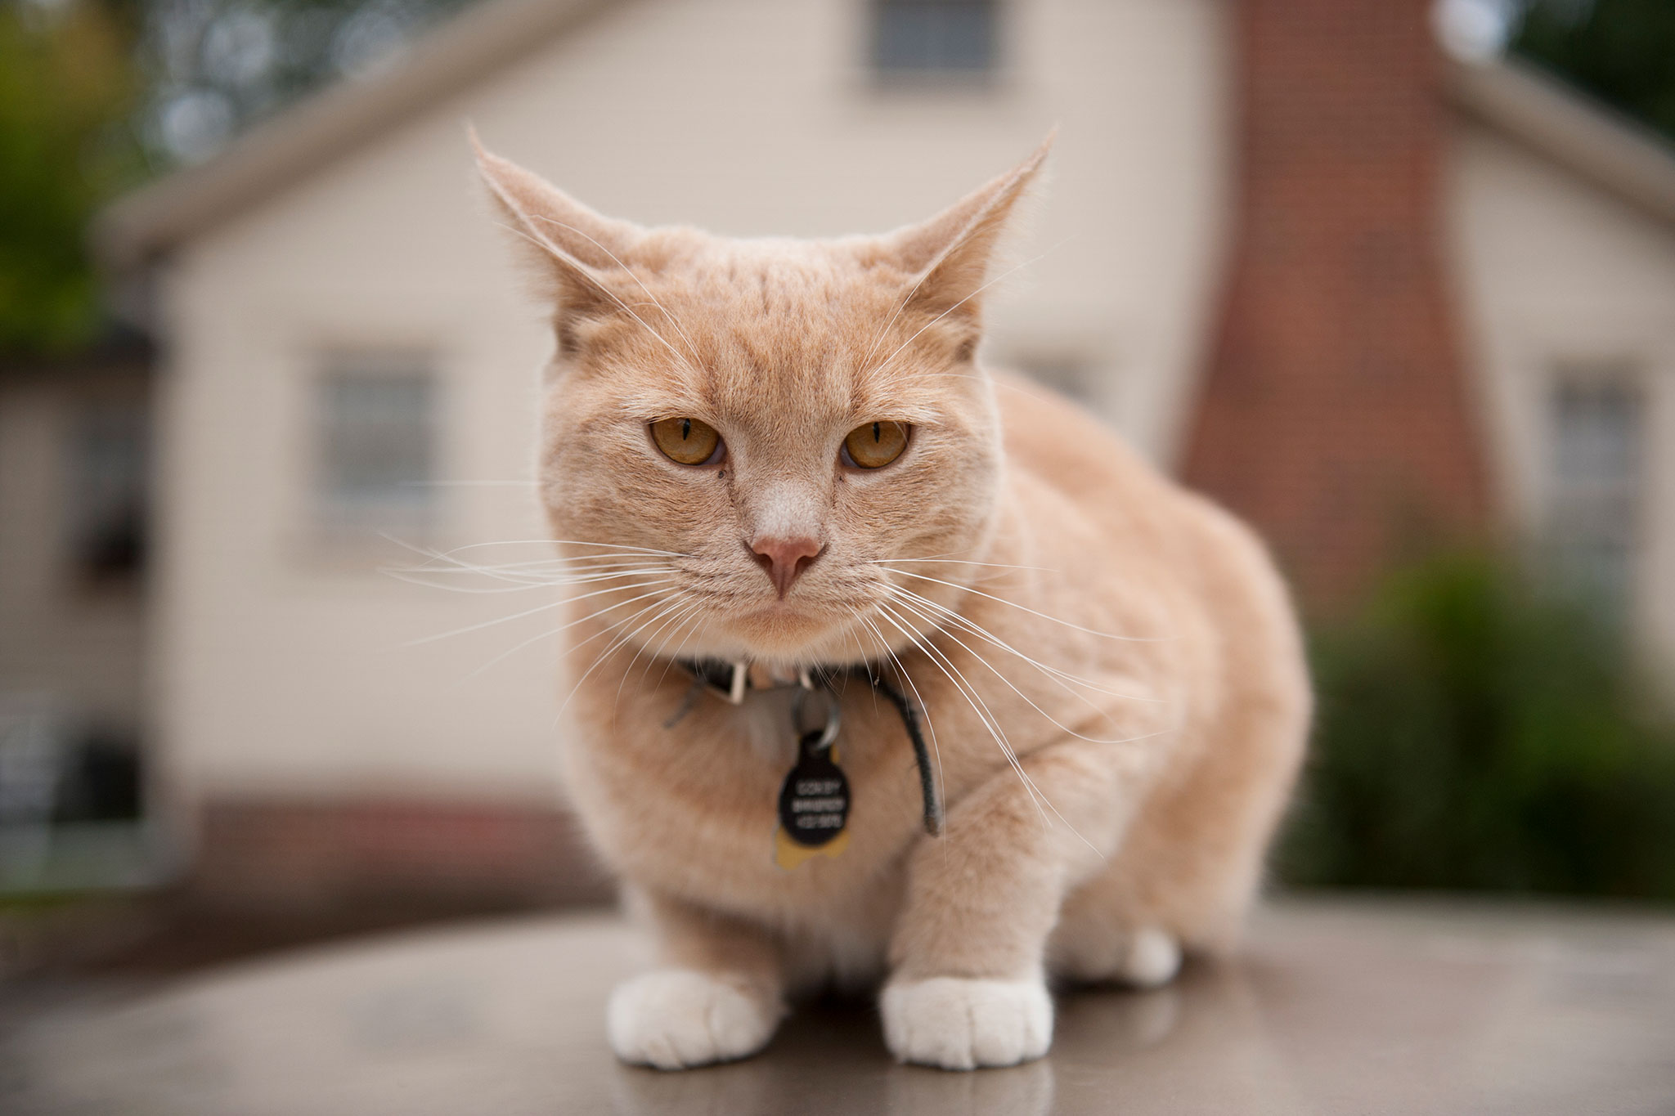
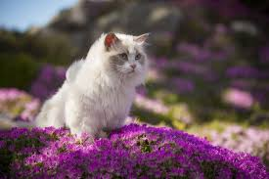
Informative Writing:Cats

Slide 2
Cats are domestic animals

Slide 3
Most Cats have fur

Slide 4
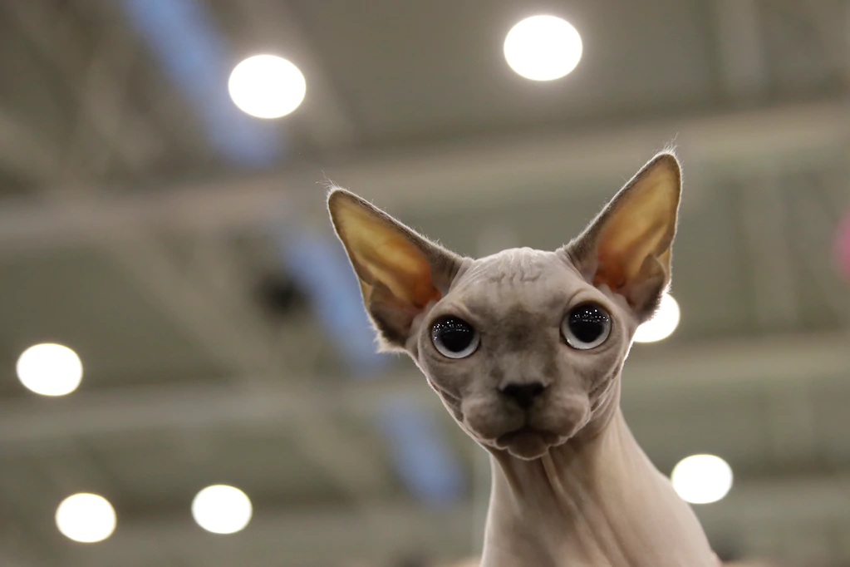
But some don’t

Slide 5
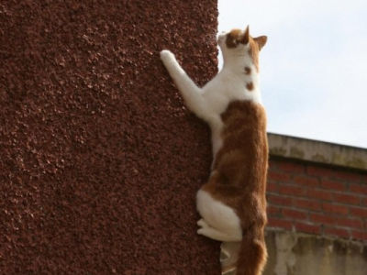
All cats can climb

Slide 6
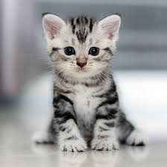
Baby cats are called kittens

Slide 7
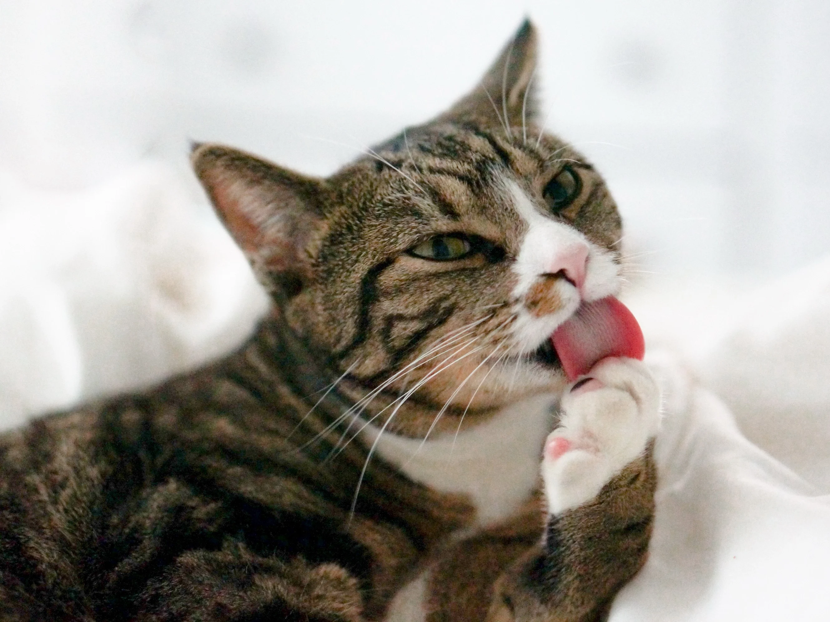
Cats lick their body to keep clean

Slide 8
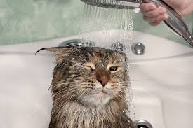
Cats don’t like water

